Slide 1
Layouts

Slide 2
Layouts
A layout defines the visual structure for a user interface, such as the UI for an activity or app widget. You can declare a layout in two ways:
Declare UI elements in XML.
Android provides a straightforward XML vocabulary that corresponds to the View classes and subclasses, such as those for widgets and layouts.
Instantiate layout elements at runtime.
Your application can create View and ViewGroup objects (and manipulate their properties) programmatically.

Slide 3
Layouts
The advantage to declaring your UI in XML is that:
it enables you to better separate the presentation of your application from the code that controls its behavior.
Your UI descriptions are external to your application code, which means that you can modify or adapt it without having to modify your source code and recompile.
You can create XML layouts for different screen orientations, different device screen sizes, and different languages.
Additionally, declaring the layout in XML makes it easier to visualize the structure of your UI, so it's easier to debug problems.
As such, this document focuses on teaching you how to declare your layout in XML.
If you're interested in instantiating View objects at runtime, refer to the ViewGroup and View class references.

Slide 4
Layouts
In general, the XML vocabulary for declaring UI elements closely follows the structure and naming of the classes and methods, where element names correspond to class names.
In fact, the correspondence is often so direct that you can guess what XML attribute corresponds to a class method, or guess what class corresponds to a given XML element. However, note that not all vocabulary is identical.

Slide 5
Write the XML
Each layout file must contain exactly one root element, which must be a View or ViewGroup object.
Once you've defined the root element, you can add additional layout objects or widgets as child elements to gradually build a View hierarchy that defines your layout.

Slide 6
Write the XML
For example, here's an XML layout that uses a vertical LinearLayout to hold a TextView and a Button:
<?xml version="1.0" encoding="utf-8"?>
<LinearLayout xmlns:android="http://schemas.android.com/apk/res/android"
android:layout_width="match_parent"
android:layout_height="match_parent"
android:orientation="vertical" >
<TextView android:id="@+id/text"
android:layout_width="wrap_content"
android:layout_height="wrap_content"
android:text="Hello, I am a TextView" />
<Button android:id="@+id/button"
android:layout_width="wrap_content"
android:layout_height="wrap_content"
android:text="Hello, I am a Button" />
</LinearLayout>
After you've declared your layout in XML, save the file with the .xml extension, in your Android project's res/layout/ directory, so it will properly compile.

Slide 7
Load the XML Resource
When you compile your application, each XML layout file is compiled into a View resource. You should load the layout resource from your application code, in your Activity.onCreate() callback implementation.
Do so by calling setContentView(), passing it the reference to your layout resource in the form of: R.layout.layout_file_name.
For example, if your XML layout is saved as main_layout.xml, you would load it for your Activity like so:
public void onCreate(Bundle savedInstanceState) {
super.onCreate(savedInstanceState);
setContentView(R.layout.main_layout);
}
The onCreate() callback method in your Activity is called by the Android framework when your Activity is created

Slide 8
Class Hierarchy
Object
View
ViewGroup
AbsoluteLayout
FrameLayout
GridLayout
LinearLayout
RelativeLayout
ConstraintLayout

Slide 9
Attributes
Every View and ViewGroup object supports their own variety of XML attributes. Some attributes are specific to a View object (for example, TextView supports the textSize attribute), but these attributes are also inherited by any View objects that may extend this class.
Some are common to all View objects, because they are inherited from the root View class (like the id attribute). And, other attributes are considered "layout parameters," which are attributes that describe certain layout orientations of the View object, as defined by that object's parent ViewGroup object

Slide 10
ID Attribute
Any View object may have an integer ID associated with it, to uniquely identify the View within the tree.
When the application is compiled, this ID is referenced as an integer, but the ID is typically assigned in the layout XML file as a string, in the id attribute.
This is an XML attribute common to all View objects (defined by the View class) and you will use it very often. The syntax for an ID, inside an XML tag is:
android:id="@+id/my_button“
The at-symbol (@) at the beginning of the string indicates that the XML parser should parse and expand the rest of the ID string and identify it as an ID resource.
The plus-symbol (+) means that this is a new resource name that must be created and added to our resources (in the R.java file).

Slide 11
ID Attribute
There are a number of other ID resources that are offered by the Android framework. When referencing an Android resource ID, you do not need the plus-symbol, but must add the android package namespace, like so:
android:id=”@android:id/empty”
Same android:id On Multiple Activity:
findViewById() gets a reference to currently inflated layout of the activity.
Another view with the same ID in another layout will be ignored.

Slide 12
Layout Width and Height
layout_width
Specifies the basic width of the view. This is a required attribute for any view inside of a containing layout manager
layout_height
Specifies the basic height of the view. This is a required attribute for any view inside of a containing layout manager
Value may be a dimension (such as "12dip") for a constant width or one of the special constants.
May be a dimension value, which is a floating point number appended with a unit such as "14.5sp". Available units are: px (pixels), dp (density-independent pixels), sp (scaled pixels based on preferred font size), in (inches), and mm (millimeters).
Constant | Description
match_parent | The view should be as big as its parent (minus padding). Introduced in API Level 8.
wrap_content | The view should be only big enough to enclose its content (plus padding).

Slide 13
Gravity vs Layout Gravity
gravity
It is used to specify how to place the content of the object within the object itself. In another word, it is used to specify the gravity of the content of the view.
layout_gravity
It is an attribution the child can supply to its parent, to specify the gravity the view within its parents.

Slide 14
layout_gravity and gravity constants
Constant | Description
bottom | Push object to the bottom of its container, not changing its size.
center | Place the object in the center of its container in both the vertical and horizontal axis, not changing its size.
center_horizontal | Place object in the horizontal center of its container, not changing its size.
center_vertical | Place object in the vertical center of its container, not changing its size.
clip_horizontal | Additional option that can be set to have the left and/or right edges of the child clipped to its container's bounds. The clip will be based on the horizontal gravity: a left gravity will clip the right edge, a right gravity will clip the left edge, and neither will clip both edges.
clip_vertical | Additional option that can be set to have the top and/or bottom edges of the child clipped to its container's bounds. The clip will be based on the vertical gravity: a top gravity will clip the bottom edge, a bottom gravity will clip the top edge, and neither will clip both edges.
end | Push object to the end of its container, not changing its size.
fill | Grow the horizontal and vertical size of the object if needed so it completely fills its container.
fill_horizontal | Grow the horizontal size of the object if needed so it completely fills its container.
fill_vertical | Grow the vertical size of the object if needed so it completely fills its container.
left | Push object to the left of its container, not changing its size.
right | Push object to the right of its container, not changing its size.
start | Push object to the beginning of its container, not changing its size.
top | Push object to the top of its container, not changing its size.

Slide 15
Bridging XML and Java
In order to create views and reference them from the application, a common pattern is to:
1. Define a view/widget in the layout file and assign it a unique ID:
<Button android:id="@+id/myButton"
android:layout_width="wrap_content"
android:layout_height="wrap_content"
android:text=”OK”/>
2. Then create an instance of the view object and capture it from the layout (typically in the onCreate() method):
Button myButton = (Button) findViewById(R.id.myButton);

Slide 16
Common Layouts
RelativeLayout
AbsoluteLayout
FrameLayout
GridLayout
LinearLayout

Slide 17
Relative Layout
RelativeLayout is a view group that displays child views in relative positions.
The position of each view can be specified as relative to sibling elements (such as to the left-of or below another view) or in positions relative to the parent RelativeLayout area (such as aligned to the bottom, left or center).
A RelativeLayout is a very powerful utility for designing a user interface because it can eliminate nested view groups and keep your layout hierarchy flat, which improves performance.
If you find yourself using several nested LinearLayout groups, you may be able to replace them with a single RelativeLayout

Slide 18
Relative Layout: Positioning Views
RelativeLayout lets child views specify their position relative to the parent view or to each other (specified by ID).
So you can align two elements by right border, or make one below another, centered in the screen, centered left, and so on.
By default, all child views are drawn at the top-left of the layout, so you must define the position of each view using the various layout properties available from RelativeLayout.LayoutParams.

Slide 19
Relative Layout: Positioning Views
Some of the many layout properties available to views in a RelativeLayout include:
android:layout_alignParentTop
If "true", makes the top edge of this view match the top edge of the parent.
android:layout_centerVertical
If "true", centers this child vertically within its parent.
android:layout_below
Positions the top edge of this view below the view specified with a resource ID.
android:layout_toRightOf
Positions the left edge of this view to the right of the view specified with a resource ID.
These are just a few examples. All layout attributes are documented at RelativeLayout.LayoutParams.

Slide 20
Absolute Layout
AbsoluteLayout lets you specify exact locations (x/y coordinates) of its children.
Absolute layouts are less flexible and harder to maintain than other types of layouts without absolute positioning.
Following are the important attributes specific to AbsoluteLayout:
Sr.No | Attribute & Description
1 | android:id This is the ID which uniquely identifies the layout.
2 | android:layout_x This specifies the x-coordinate of the view.
3 | android:layout_y This specifies the y-coordinate of the view.

Slide 21
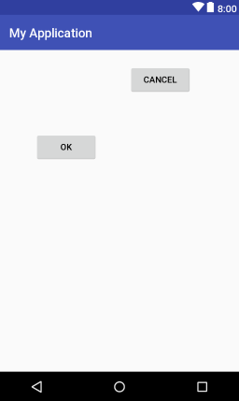
Absolute Layout
<AbsoluteLayout xmlns:android="http://schemas.android.com/apk/res/android" android:layout_width="match_parent" android:layout_height="match_parent"> <Button android:layout_width="100dp" android:layout_height="wrap_content" android:layout_x="57dp" android:layout_y="130dp" android:text="OK" /> <Button android:layout_width="100dp" android:layout_height="wrap_content" android:layout_x="207dp" android:layout_y="23dp" android:text="Cancel" /> </AbsoluteLayout>

Slide 22
Frame Layout
FrameLayout is designed to block out an area on the screen to display a single item.
You can add multiple children to a FrameLayout and control their position within the FrameLayout by assigning gravity to each child, using the android:layout_gravity attribute.

Slide 23
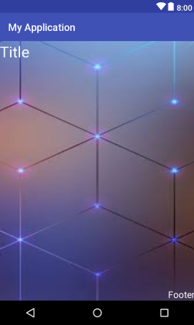
Frame Layout
<FrameLayout . . . android:layout_width="match_parent" android:layout_height="match_parent"> <ImageView android:id="@+id/imageView1" android:layout_width="match_parent" android:layout_height="match_parent" android:scaleType="fitXY" app:srcCompat="@drawable/background1" /> <TextView android:id="@+id/textView1" android:layout_width="match_parent" android:layout_height="wrap_content" android:gravity=“left" android:textColor="@android:color/white" android:textSize="30sp" tools:text="Title" /> <TextView android:id="@+id/textView2" android:layout_width="match_parent" android:layout_height="wrap_content" android:layout_gravity="bottom" android:gravity="right" android:textColor="@android:color/white" android:textSize="18sp" tools:text="Footer" /> </FrameLayout>

Slide 24
Grid Layout
GridView give flexibility to arrange components in a two-dimensional scrolling grid.
A layout that places its children in a rectangular grid.
The grid is composed of a set of infinitely thin lines that separate the viewing area into cells. Throughout the API, grid lines are referenced by grid indices.
Child view can use layout_row and layout_colums number (starting from 0)
XML attributes
android:alignmentMode | When set to alignMargins, causes alignment to take place between the outer boundary of a view, as defined by its margins.
android:columnCount | The maxmimum number of columns to create when automatically positioning children.
android:columnOrderPreserved | When set to true, forces column boundaries to appear in the same order as column indices.
android:orientation | The orientation property is not used during layout.
android:rowCount | The maxmimum number of rows to create when automatically positioning children.
android:rowOrderPreserved | When set to true, forces row boundaries to appear in the same order as row indices.
android:useDefaultMargins | When set to true, tells GridLayout to use default margins when none are specified in a view's layout parameters.

Slide 25
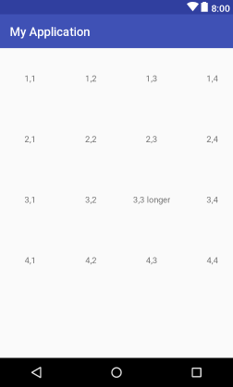
Grid Layout
<GridLayout xmlns:android="http://schemas.android.com/apk/res/android" android:layout_width="match_parent" android:layout_height="wrap_content" android:columnCount="4" android:rowCount="4"> <TextView android:text="1,1" android:gravity="center"/> <TextView android:text="1,2" android:gravity="center"/> /> <TextView android:text="1,3" android:gravity="center"/> /> . . . <TextView android:text="3,3 longer" " android:gravity="center"/> /> . . . <TextView android:text="4,4" android:gravity="center"/>/> </GridLayout>

Slide 26
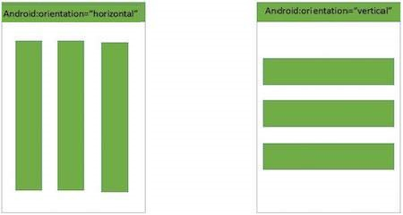
Linear Layout
A layout that arranges other views either horizontally in a single column or vertically in a single row.

Slide 27
Linear Layout
Attributes and Description
Sr.No | Attribute & Description
1 | android:id This is the ID which uniquely identifies the layout.
5 | android:gravity This specifies how an object should position its content, on both the X and Y axes. Possible values are top, bottom, left, right, center, center_vertical, center_horizontal etc.
6 | android:orientation This specifies the direction of arrangement and you will use "horizontal" for a row, "vertical" for a column. The default is horizontal.
7 | android:weightSum Sum up of child weight

Slide 28
Linear Layout: Example
<?xml version="1.0" encoding="utf-8"?> <LinearLayout xmlns:android="http://schemas.android.com/apk/res/android" android:layout_width="fill_parent" android:layout_height="fill_parent" android:orientation="vertical" > <Button android:id="@+id/btnStartService" android:layout_width="270dp" android:layout_height="wrap_content" android:text="start_service"/> <Button android:id="@+id/btnPauseService" android:layout_width="270dp" android:layout_height="wrap_content" android:text="pause_service"/> <Button android:id="@+id/btnStopService" android:layout_width="270dp" android:layout_height="wrap_content" android:text="stop_service"/> </LinearLayout>

Slide 29
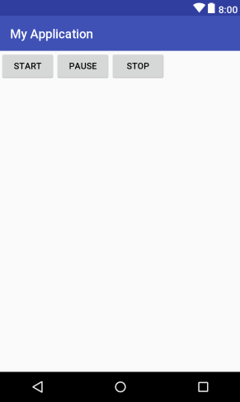
Linear Layout: Example
<?xml version="1.0" encoding="utf-8"?> <LinearLayout xmlns:android="http://schemas.android.com/apk/res/android" android:layout_width="fill_parent" android:layout_height="fill_parent" android:orientation="horizontal" > <Button android:id="@+id/btnStartService" android:layout_width="wrap_content" android:layout_height="wrap_content" android:text="Start"/> <Button android:id="@+id/btnPauseService" android:layout_width="wrap_content" android:layout_height="wrap_content" android:text="Pause"/> <Button android:id="@+id/btnStopService" android:layout_width="wrap_content" android:layout_height="wrap_content" android:text="Stop"/> </LinearLayout>

Slide 30
Layout can be nested
Normally a UI contains more than one Layout.
Layouts can be nested to define a complex UI.

Slide 31
Sample R.java file
The new Android Gradle Plugin generates the corresponding bytecode directly and does not make the intermediate R.java file.
You may see the sample R.java file to have idea about its structure.
Sample R.java file

